Slide 1
Introduction To Java
Application Development in Java

Slide 2
Objectives
Explain the structure of a Java class
List and explain steps to write a Java program
Explain the steps to develop, compile, and execute Java program using
Noted pad ++
Explain the various components of JVM
Describe comments in Java

Slide 3
Introduction 1-2
Java is a popular OOP language that supports developing applications for different requirements and domain areas.
All types of applications can be developed:
In a simple text editor, such as Notepad++.
In an environment that provides necessary tools to develop a Java application.
The environment is called as Integrated Development Environment (IDE).

Slide 4
Introduction 2-2
Following figure shows the type of applications developed using Java
Java Applications
Console-based Application
Server-side Web Components
JavaBeans Component
Applets
Window-based Application
Enterprise Components

Slide 5

Structure of a Java Class 1-8 Package
Defines a namespace that stores classes with similar functionalities in them.
The package keyword identifies:
Name of the package to which the class belongs.
Visibility of the class within the package and outside the package.
The concept of package is similar to folder in the OS.
In Java, all classes belongs to a package. If the package statement is not specified, then the class belongs to the default package.

Slide 6
Structure of a Java Class 2-8
The Java programming language is designed around object-oriented features and begins with a class design.
The class represents a template for the objects created or instantiated by the Java runtime environment.
The definition of the class is written in a file and is saved with a .java extension.
Following figure shows the basic structure of a Java class.

Slide 7

Structure of a Java Class 3-8 import
Identifies the classes and packages that are used in a Java class.
Helps to narrow down the search performed by the Java compiler by informing it about the classes and packages.
Mandatory to import the required classes, before they are used in the Java program.
Some exceptions wherein the use of import statement is not required are as follows:
If classes are present in the java.lang package.
If classes are located in the same package.
If classes are declared and used along with their package name.

Slide 8
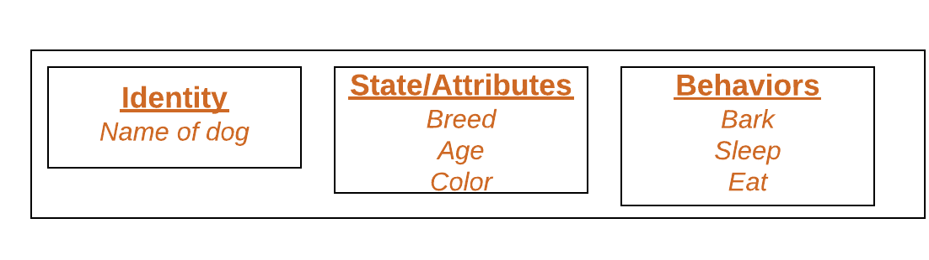
Structure of a Java Class 4-8 Object
Objects have states and behaviors.
An object is an instance of a class.
Example: A dog has states - color, name, breed as well as behaviors – wagging the tail, barking, eating.
An object consists of :
State : It is represented by attributes of an object. It also reflects the properties of an object.
Behavior : It is represented by methods of an object. It also reflects the response of an object with other objects.
Identity : It gives a unique name to an object and enables one object to interact with other objects.

Slide 9

Structure of a Java Class 5-8
A Class is user defined blueprint or Template or
Prototype from which Objects are Created.
It represents the Set of Properties or Methods that are common to All Objects of one Type.
Class Keyword identifies a java Class
Precedes the name of the class in the declaration.
public keyword indicates the access modifier that decides the visibility of the class.
Name of a class and file name should match.
The name should begin with a initial letter (capitalized by convention).
class

Slide 10
Structure of a Java Class 6-8
A Java variable is a piece of memory that can contain a data value. A variable thus has a data type. Data types are covered in more detail in the text on Java data types
Variables are typically used to store information which your Java program needs to do its job. This can be any kind of information ranging from texts, codes (e.g. country codes, currency codes etc.) to numbers, temporary results of multi step calculations etc.
Are also referred to as instance fields or instance variables.
Represent the state of objects.
For Example
int number =30;
number=number+10;
Variables

Slide 11
Structure of a Java Class 7-8
Methods
A method is a collection of statements that perform some specific task and return the result to the caller.
A method can perform some specific task without returning anything.
Methods allow us to reuse the code without retyping the code.
Are functions that represent some action to be performed on an object.
Are also referred to as instance methods.
Are also methods or functions that are invoked during the creation of an object.
a constructor also contains collection of statements(i.e. instructions) that are executed at time of Object creation.
Used to initialize the objects.
Constructors

Slide 12
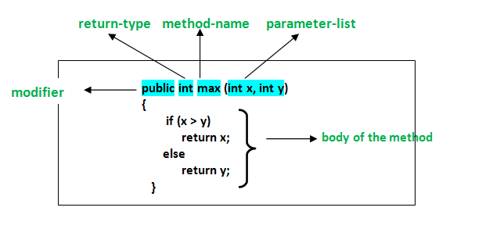
Structure of a Java Class 8-8

Slide 13
Developing a Java Program on Windows
Basic requirements to write a Java program are as follows:
The JDK 8 installed and configured on the system.
A text editor, such as Notepad.
To create, compile, and execute a Java program, perform the
Create a Java program
Compile .java file
Build and execute Java program

Slide 14
Create a Java Program 1-4
Following code snippet demonstrates a simple Java program:
class is a keyword and HelloWorld is the name of the class.
The entire class definition and its members must be written within the opening and closing curly braces {}.
The area between the braces is known as the class body and contains the code for that class.
public class HelloWorld { public static void main(String[] args) { System.out.println(“Welcome to the world of Java”); } }

Slide 15
Create a Java Program 2-4
Following code snippet demonstrates a simple Java program:
main()- method is the entry point for a java-based console application.
public - Is a keyword that enables the JVM to access the main() method.
static - Is a keyword that allows a method to be called from outside a class without creating an instance of the class.
void - Is a keyword that represents the data type of the value returned by the main() method. It informs the compiler that the method will not return any value.
args - Is an array of type String and stores command line arguments. String is a class in Java and stores group of characters.
public class HelloWorld { public static void main(String[] args) { System.out.println(“Welcome to the world of Java”); } }

Slide 16
Create a Java Program 3-4
Following code snippet demonstrates a simple Java program:
System.out.println() statement displays the string that is passed as an argument.
System is the predefined class and provides access to the system resources, such as console.
out is the output stream connected to the console.
println() is the built-in method of the output stream that is used to display a string.
public class HelloWorld { public static void main(String[] args) { System.out.println(“Welcome to the world of Java”); } }

Slide 17
Create a Java Program 4-4
Following code snippet demonstrates a simple Java program:
Save the file as HelloWorld.java.
The file name is same as class name, as the compilation of a Java code results in a class. Hence, the class name and the file name should be same.
public class HelloWorld { public static void main(String[] args) { System.out.println(“Welcome to the world of Java”); } }

Slide 18
Compile .java File 1-3
Following figure shows the compilation process of the Java program.
The HelloWorld.java file is known as source code file.
It is compiled by invoking tool named javac.exe, which compiles the source code into a .class file.
The .class file contains the bytecode which is interpreted by java.exe tool.
java.exe interprets the bytecode and runs the program.

Slide 19
Compile .java File 2-3
The syntax to use the javac.exe command:
where,
source - Is one or more file names that end with a .java extension.
Syntax
javac [option] source

Slide 20
Compile .java File 3-3
To compile the HelloWorld.java program from the Windows platform, the user can:
Click Start menu.
Choose Run.
Enter the cmd command to display the Command Prompt window.
Following figure shows the Command Prompt window:
Set the drive and directory path to the directory containing .java file. For example, cd H:\Java.
Type the command, javac HelloWorld.java and press Enter.

Slide 21
Build and Execute Java Program 1-3
The JVM is at the heart of the Java programming language.
It is responsible for executing the .class file or bytecode file.
The .class file can be executed on any computer or device, that has the JVM implemented on it.
Following figure shows the components of JVM involved in the execution of the compiled bytecode.

Slide 22
Build and Execute Java Program 2-3
The class loader component of JVM loads all the necessary classes from the runtime libraries required for execution of the compiled bytecode.
The bytecode verifier then checks the code to ensure that it adheres to the JVM specification.
To boost the speed of execution, in Java version 2.0, a Hot Spot Just-in-Time (JIT) compiler was included at runtime.
The bytecode is executed by the interpreter.
During execution, the JIT compiler compiles some of the code into native code or platform-specific code to boosts the performance.

Slide 23
Build and Execute Java Program 3-3
The Java interpreter command, java is used to interpret and run the Java bytecode.
The syntax to use the java.exe command is as follows:
where,
classname: Is the name of the class file.
arguments: Is the arguments passed to the main function.
To execute the HelloWorld class, type the command, java HelloWorld and press Enter.
Syntax
java [option] classname [arguments]]

Slide 24
Comments in Java
Are placed in a Java program source file.
Are used to document the Java program and are not compiled by the compiler.
Are added as remarks to make the program more readable for the user.
Are of three types:
Single-line comments
Multi-line comments
Javadoc comments

Slide 25
Single-line Comments 1-2
A single-line comment is used to document the functionality of a single line of code.
There are two ways of using single-line comments that are as follows:
The syntax for applying the comments is as follows:
This type of comment can be placed before the code (on a different line).
End-of-line comment
This type of comment is placed at the end of the code (on the same line).
Beginning-of-line comment
Syntax
// Comment text

Slide 26
Single-line Comments 2-2
Following code snippet shows the different ways of using single-line comments in a Java program:
Conventions for using single-line comments are as follows:
Insert a space after the forward slashes.
Capitalize the first letter of the first word.
... // Declare a variable int a = 32; int b // Declare a variable ...

Slide 27
Multi-line Comments
Is a comment that spans multiple lines.
Starts with a forward slash and an asterisk (/*).
Ends with an asterisk and a forward slash (*/).
Anything that appears between these delimiters is
considered to be a comment.
Following code snippet shows a Java program that uses
multi-line comments:
... /* * This code performs mathematical * operation of adding two numbers. */ int a = 20; int b = 30; int c; c = a + b; ...

Slide 28
Javadoc Comments 1-2
Is used to document public or protected classes, attributes, and methods.
Starts with /** and ends with */.
Everything between the delimiters is a comment.
The javadoc command can be used for generating Javadoc comments.
Following code snippet demonstrates the use of Javadoc comments in the Java program:
/** * The program prints the welcome message * using the println() method. */ package hellomessageapp;

Slide 29
Javadoc Comments 2-2
/** * * @author vincent */ public class HelloMessageApp { /** * @param args the command line arguments */ public static void main(String[] args) { // The println() method displays a message on the screen System.out.println(“Welcome to the world of Java”); } }

Slide 30
Summary
The Java programming language is designed around object-oriented features and begins with a class design.
A Java class structure contains the following components namely, package, import, class name, variables, and methods.
Java programs can be written in a text editor, such as Notepad or in an IDE, such as NetBeans.
The entry point for a Java console application is the main() method.
The javac.exe compiles the source code into a .class file. Similarly, the java.exe command is used to interpret and run the Java bytecodes.
NetBeans is a free and robust IDE that helps developers to create cross-platform desktop, Web, and mobile applications using Java.
Comments are used to document the Java program and are not compiled by the compiler. There are three styles of comments supported by Java namely, single-line, multi-line, and Javadoc.

